Slide 1


NTUC LearningHub Capstone Project 2: Relational Database and MS Excel Dashboard
INSURANCE CLAIM
(Predictive Data Analytics)
Hung Lin Lin
This Photo by Unknown Author is licensed under CC BY-SA

Slide 2


Content
Introduction
Role
Business Problem Overview
Solution Approach
Data Overview
Data Reprocessing
Entity Relationship Diagram
Schema and Table Diagram
SQL Queries
Excel Chart
Exporting Database to Excel CSV
Executive Summary
Actionable Insights
Recommendations

Slide 3


Role
Data Analyst for an insurance company
Reporting to Directors of various departments
--------------------------------------------------------------------------------------------------------
Business Problem Overview
By analyzing key factors across geographical areas and across different demographics such as age or gender, we can gain a greater understanding of the demographic patterns of people who is most likely to receive an insurance claim. This understanding gives us valuable insight that can be used to inform our decision making when considering potential customers for our services.
Insurance Claim Analysis: Demographic and Health | Kaggle
--------------------------------------------------------------------------------------------------------
Solution Approach
Extract, Transform, Load
SQL Query
Share insights and recommendations

Slide 4

Data Overview
This dataset contains information related to insurance claims. The dataset contains information on patient age, gender, BMI (Body Mass Index), blood pressure levels, diabetic status, number of children, smoking status and region. There are 4 columns of text type and 6 columns of numeric type.
Observations | Variables
1340 | 10
Column name | Description
Diabetic | Whether the insured person is diabetic or not. (Boolean)
Children | Number of children of the insured person. (Integer)
Smoker | Whether the insured person is a smoker or not. (Boolean)
Claim | Amount of the insurance claim. (Float)

Slide 5

Data Reprocessing
Removal of “index”, as it has running serial number, just like PatientID, but it starts at 0, instead of 1, thus it is deemed redundant and PatientID is preferred. With example of first 5 rows.
There is no duplicate (checked through PatientID) value.
There are 5 blank cells for “age” and 3 for “region”. They may be left blank by the clients due to non-disclosure. We will leave out these blank cells during query, instead of inputting values, so as not to create bias in data.
index | PatientID
0 | 1
1 | 2
2 | 3
3 | 4
4 | 5
PatientID | age | gender | bmi | bloodpressure | diabetic | children | smoker | region | claim
1 | 39 | male | 23.2 | 91 | Yes | 0 | No | southeast | 1121.87
2 | 24 | male | 30.1 | 87 | No | 0 | No | southeast | 1131.51
3 |  | male | 33.3 | 82 | Yes | 0 | No | southeast | 1135.94
4 |  | male | 33.7 | 80 | No | 0 | No | northwest | 1136.4
5 |  | male | 34.1 | 100 | No | 0 | No | northwest | 1137.01
6 |  | male | 34.4 | 96 | Yes | 0 | No | northwest | 1137.47
7 |  | male | 37.3 | 86 | Yes | 0 | No | northwest | 1141.45
8 | 19 | male | 41.1 | 100 | No | 0 | No | northwest | 1146.8
9 | 20 | male | 43 | 86 | No | 0 | No | northwest | 1149.4
10 | 30 | male | 53.1 | 97 | No | 0 | No | northwest | 1163.46
11 | 36 | male | 19.8 | 88 | Yes | 0 | No | northwest | 1241.57
12 | 37 | male | 20.3 | 90 | Yes | 0 | No | northwest | 1242.26
13 | 19 | male | 20.7 | 81 | No | 0 | No | northwest | 1242.82
14 | 32 | male | 27.6 | 100 | No | 0 | No |  | 1252.41
15 | 40 | male | 28.7 | 81 | Yes | 0 | No |  | 1253.94
16 | 32 | male | 30.4 | 86 | Yes | 0 | No |  | 1256.3
17 | 35 | male | 34.1 | 90 | No | 0 | No | southwest | 1261.44
BLANK
BLANK BLANK BLANK BLANK
BLANK
BLANK BLANK

Slide 6
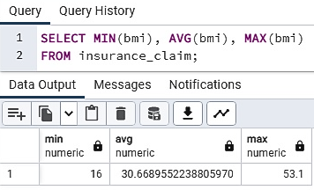
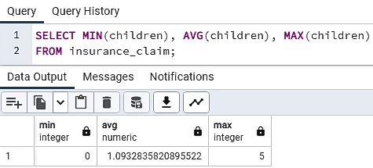
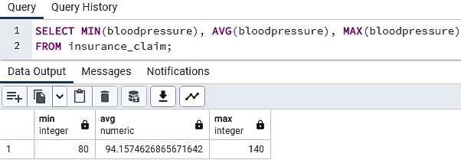
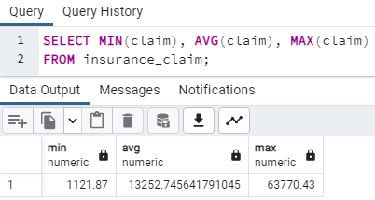
There are outliers detected for these attributes, as they are heavily skewed to the right. However, being proper value, they are not treated.
bmi : minimum 16, average ~30.7 and max 53.1
bloodpressure: minimum 80, average ~94.2 and max 140
children : minimum 0, average ~ 1.1 and max 5
claim : minimum 80, average ~94.2 and max 140

Slide 7
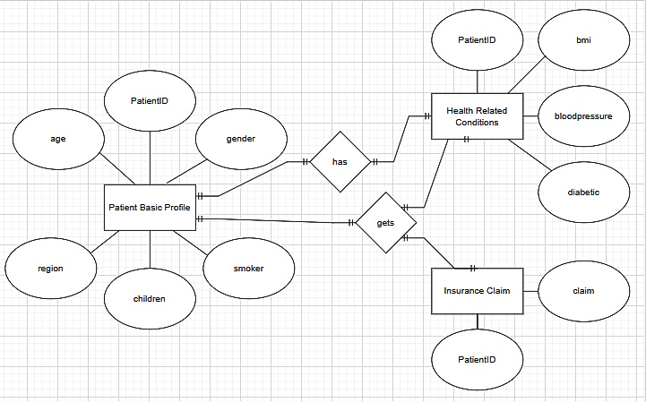
Entity Relationship Diagram

Slide 8
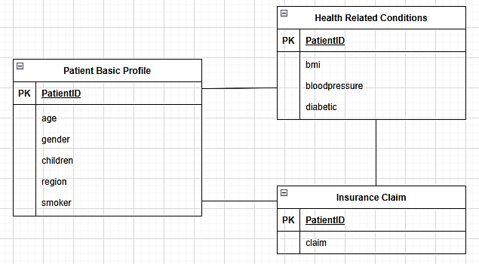
Schema and Table Diagram

Slide 9
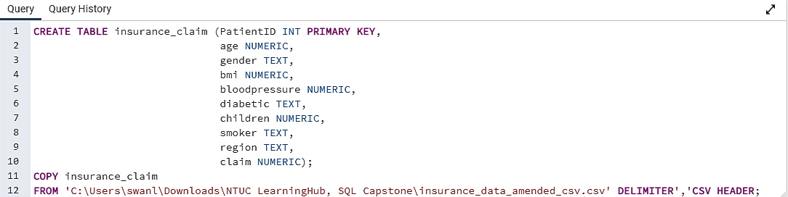
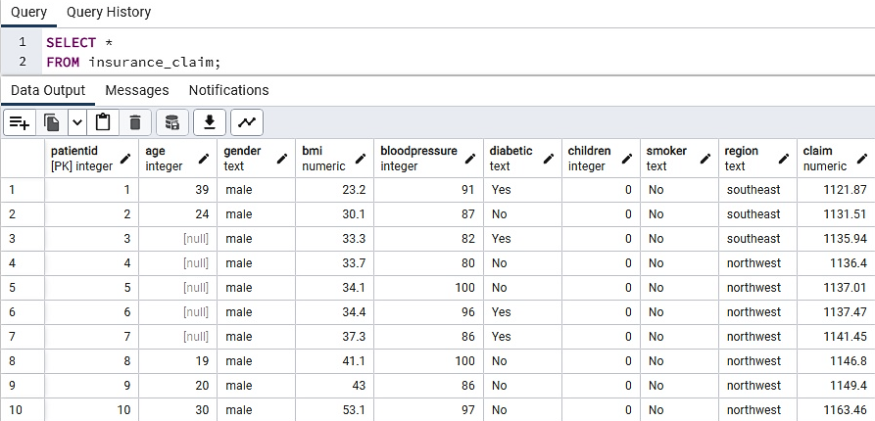
Create Table
SQL QUERY
Initial
Observation of First 10 Rows of Data
Null values observed.

Slide 10
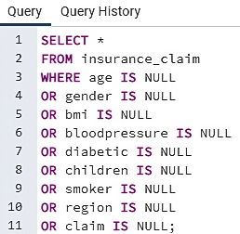
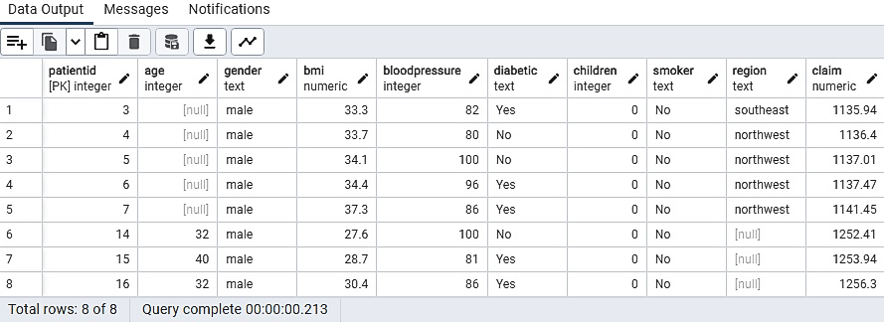
Check on NULL Values
In total, there are 8 NULL values. 5 in age and 3 in region.

Slide 11

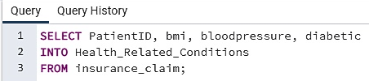

DATA Normalisation Importing the Data into 3 Tables to Satisfy the Third Normal Form
First Normal Form
All rows must be unique (no duplicate rows)
Each cell must only contain a single value (not a list)
Each value should be non divisible (can’t be split down further)
Second Normal Form
Database must be in First Normal Form.
Non partial dependency – All non-prime attributes should be fully functionally dependent on the candidate key.
Third Normal Form
Database must be in First & Second Normal Form
No transitive dependency – All fields must only be determinable by the primary/composite key, not by other keys.

Slide 12
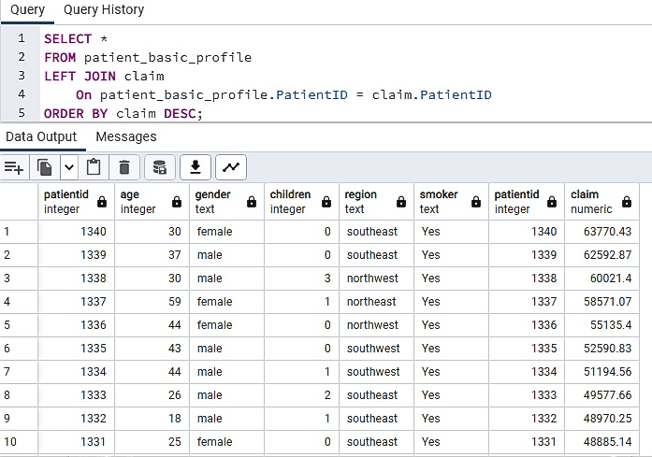
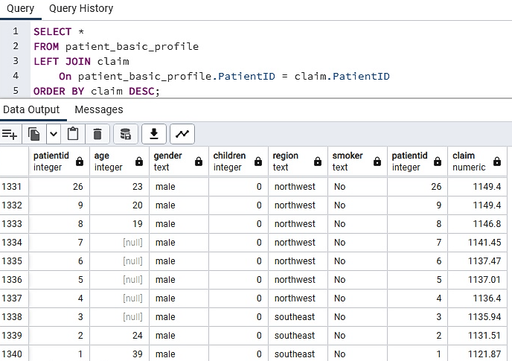
Patient_basic_profile JOIN Claim First 10 rows
Patient_basic_profile JOIN Claim Last 10 rows

Slide 13
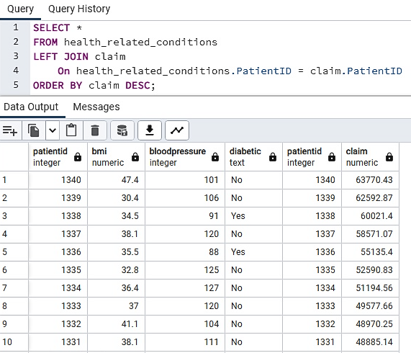
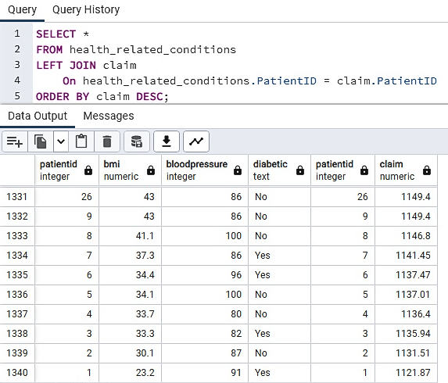
Health_related_conditions JOIN Claim First 10 rows
Health_related_conditions JOIN Claim Last 10 rows

Slide 14
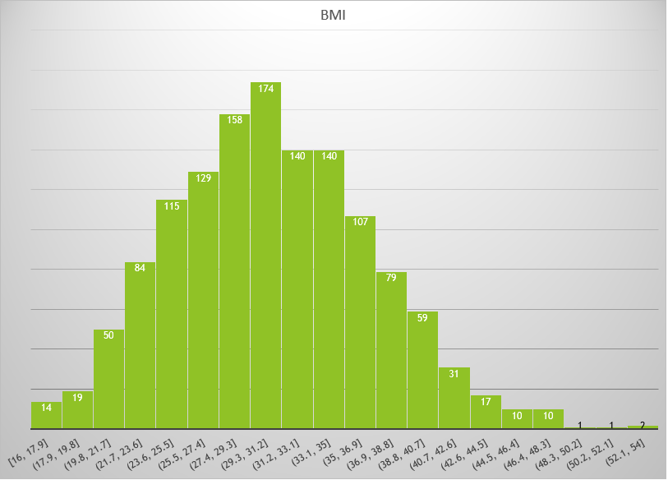
Chart on BMI of Clients

Slide 15
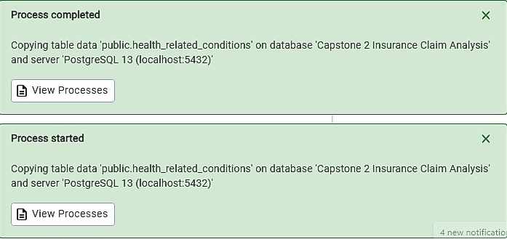
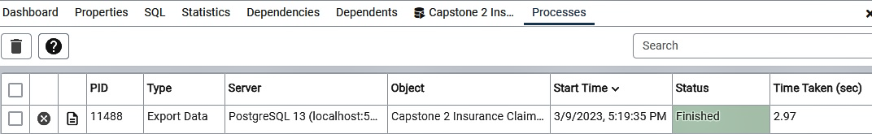
Exporting Database to Excel CSV

Slide 16

Executive Summary
Actionable Insights
Those who are smokers can have highest claim amount, while non-smokers can have lowest claim amount. Thus higher insurance premium should be considered for smokers.
Those with children are not among those getting lowest claim amount, but those with no children can also be among those getting highest claim amount. Average children is 1.1, meaning most people are just having one or even no children, which can be associated with the decline in birth rate, rather than more people with 0 or 1 children making more claim.
High BMI can be a contributing factor towards getting claim. Most of the clients have high BMI, with average BMI ~30.7 and max 53.1, which both by health guide, will fall within the obesity range.
If your BMI is 25.0 to <30, it falls within the overweight range.
If your BMI is 30.0 or higher, it falls within the obesity range.
https://www.cdc.gov/obesity/basics/adult-defining.html#:~:text=Adult%20Body%20Mass%20Index&text=If%20your%20BMI%20is%20less,falls%20within%20the%20obesity%20range
Notes:
Factor analysis is a statistical method used to describe variability among observed, correlated variables in terms of a potentially lower number of unobserved variables called factors. For example, it is possible that variations in six observed variables mainly reflect the variations in two unobserved (underlying) variables.
Factor analysis – Wikipedia
Clustering or cluster analysis is a type of data analysis. The analyst groups objects so that objects in the same group (called a cluster) are more similar to each other than to objects in other groups (clusters) in some way. This is a common task in data mining.
Cluster analysis - Simple English Wikipedia, the free encyclopedia

Slide 17

Recommendations
More in depth query eg multidimensional analysis (such as cluster or factor analysis) or running funnel analysis, to be conducted, and to analyse all variables in relation with one another.
Analyse on a broader scale, with further data covering more clients collected over longer period of time, so as to inform public policy and allowing more targeted support for those in need.
Notes:
Factor analysis is a statistical method used to describe variability among observed, correlated variables in terms of a potentially lower number of unobserved variables called factors. For example, it is possible that variations in six observed variables mainly reflect the variations in two unobserved (underlying) variables.
Factor analysis – Wikipedia
Clustering or cluster analysis is a type of data analysis. The analyst groups objects so that objects in the same group (called a cluster) are more similar to each other than to objects in other groups (clusters) in some way. This is a common task in data mining.
Cluster analysis - Simple English Wikipedia, the free encyclopedia

